Slide 1
Federal Health Information Model (FHIM) Supporting Effective, Secure Health Information Exchange
Steven Wagner

Slide 2
Agenda
Introduction to the FHIM
Benefits of the FHIM
How the FHIM is developed
Impact of the FHIM
Contributing to the FHIM
Current and planned activities

Slide 3

Introduction
8

Slide 4

Federal Health Information Model
Health data information model
Designed to support the federal health enterprise
Standardizes and harmonizes content
Open source Model Driven Health Tools (MDHT) automate generation of health information exchange (HIE) standards
2
Notes:
A logical information model of health data developed in collaboration with the federal partner agencies designed to support the federal health enterprise
Standardizes and harmonizes content (information, terminologies and value sets) across federal partner and standards organizations based on their priorities (e.g., MU) and use cases and
Integrates with open source Model Driven Health Tools (MDHT) to automate the generation of health information exchange (HIE) standards (e.g., interoperability specifications)

Slide 5
Federal Health Information Model…continued
Generates HIE standards for multiple Platform Specific Models (PSMs) (e.g., HL7 CDA, HL7 FHIR, NIEM, etc.)
Integrated into a robust FHA HIE framework to standardize information across the federal health enterprise
Provides models, tools and processes to help organizations implement information exchange standards
2
Notes:
Can generate HIE standards for multiple Platform Specific Models (PSMs) (e.g., Health Level 7 Consolidated Document Architecture (CDA), HL7 Fast Healthcare Interoperability Resources (FHIR), National Information Exchange Model (NIEM), etc.)
The FHIM, associated terminology models and value sets and MDHT have been integrated into a robust FHA HIE framework to standardize information across the federal health enterprise
The framework provides the models, tools and processes to help organizations (federal partners and others) implement information exchange standards

Slide 6
Federal Health Information Model…continued
Jun 2009 - chartered as an FHA project
Jan 2010 - information modeling process finalized and information modeling begins
Mar 2011 - terminology modeling begins
- integration of information and terminology models with Model Driven Health Tools begins
Jul 2013 - full integration of models and MDHT completed and first draft HIE standard produced using MDA approach
2

Slide 7

Federal Health Information Model…continued
Goal
Produce a logical, health information model that supports semantic interoperability and that is built by harmonizing information from the individual Federal partners and standards organizations
Principles
The model will be expressed in standard Unified Modeling Language (UML) notation (it may also be expressed in other notations)
The model will be designed to meet all Federal partner semantic interoperability needs for the exchange of information with other organizations
The model will support existing national health standards
The model will be in the public domain, freely available and easy to access
The model will be specified as a logical model consisting of a set of domain models
The model will not specify behaviors (operations)
The model will be made available as an XMI export

Slide 8
Benefits
8

Slide 9
Benefits of the FHIM and FHA HIE Framework
Supports the broadest range of use cases and retains use case context
Can be leveraged by organizations for internal use in systems and database development
Developed using the UML (Unified Modeling Language)
The modeling process harmonizes content (information and terminology) across organizations
Can reduce the time required to define/harmonize information by as much as 50%
Support the goals and requirements of the S&I Framework
Freely available components
Notes:
Examples of federal partners leveraging the FHA HIE Framework:
VA has used FHIM information to support their business modeling efforts, their IPO models and their general standards work
DoD has used FHIM information to support their functional modeling and iEHR work
CDC has used FHIM information to support their public health reporting community S&I Framework initiative
FDA has used FHIM information to standardize and harmonize the information defined in their HL7 standards for exchanging device and regulatory information
UML is a standard that supports the exchange of modeling information between different proprietary modeling tools. This supports the export/reuse of FHIM information to other modeling tools used by federal partners.
Estimates of time that can be reduced in modeling/harmonizing information is based on several prototypes completed by the FHIM team.

Slide 10
Benefits of the FHIM and FHA HIE Framework
Information and terminology models are integrated (2-way links between Information and Terminology models)
Support efficient standards development
Integrated with the MDHT to:
Support a model-driven approach to development of information exchange interoperability specifications
And produce specifications that can support multiple implementation platforms (PSMs), including NIEM

Slide 11
How the FHIM is Developed
8

Slide 12
FHIM and Associated Terminology Model
Initial baseline model created by drawing on existing UML models from VHA, NCI and FDA
HL7 Reference Information Model (RIM) used as a reference model for the FHIM
Developed using a standard process and style guide
Lead FHIM modeler ensures consistency, integration and harmonization across domain models
Health information divided into domains (e.g., Person, Laboratory, Medications/Pharmacy, etc.) - each domain has a modeling team
Modeling team consists of lead modeler, SMEs, Federal partner liaisons, others
Model each domain starting with existing information from baseline model
Incorporate and harmonize information from Federal partners
Incorporate and harmonize information from standards organizations
Model is versioned and stored in a repository as it is developed
Model is distributed for review/feedback by Federal partners

Slide 13
FHIM and Associated Terminology Models
FHIM links to terminology models/value sets by storing a unique value set ID
Terminology models maintain all other terminology information
FHIM maintains traceability to use cases and the HL7 EHR-S Functional Model
FHIM incorporates information from Computational Independent Models (CIMs)
FHIM is a Platform Independent Model (PIM)

Slide 14
Implementation Guide Models based on FHIM
Implementation Guide Model: containing the use cases for interoperability and a profile model:
1. Use Case Package
Interoperability Use case descriptions including pre- and post-conditions for information exchanges.
The use case may identify a specific type of business objects that are involved in the exchange (e.g. Patient, Encounter, Sample, Order, and Observation Result).
Identify human and system actors involved in information exchanges. The systems actors may represent specific types of system. An EHR system may play one or more roles in an interoperability use case

Slide 15
Implementation Guide Models based on FHIM …continued
Implementation Guide Model: containing the use cases for interoperability and a profile model:
2. Implementation Profile Model Package
Snapshots/copies of FHIM classes including:
Focal class(es) corresponding to the focal objects that are the subject of interoperability (e.g. Patient, Encounter, Sample, Order, Observation Result). Related classes that supply context to the focal objects (e.g. target records, author, custodian, ordering provider, etc.)
Including PSM-specific annotations for code generation. This tooling guidance is added to the original FHIM classes and reused

Slide 16
Implementation Guide Models based on FHIM
Constraints applied to the classes, associations and attributes in the model including:
Semantic clarifications
Cardinality constraints for associations and attributes
Usage/mandatory constraints for associations and attributes
Terminology and fixed value constraints (these constraints apply only to attributes)

Slide 17
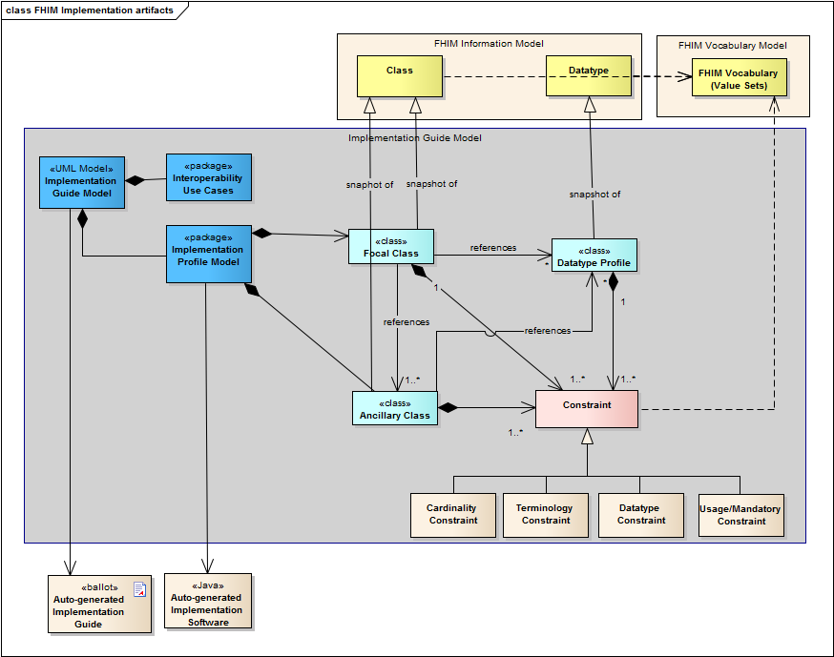
Implementation Guide Modeling Artifacts

Slide 18
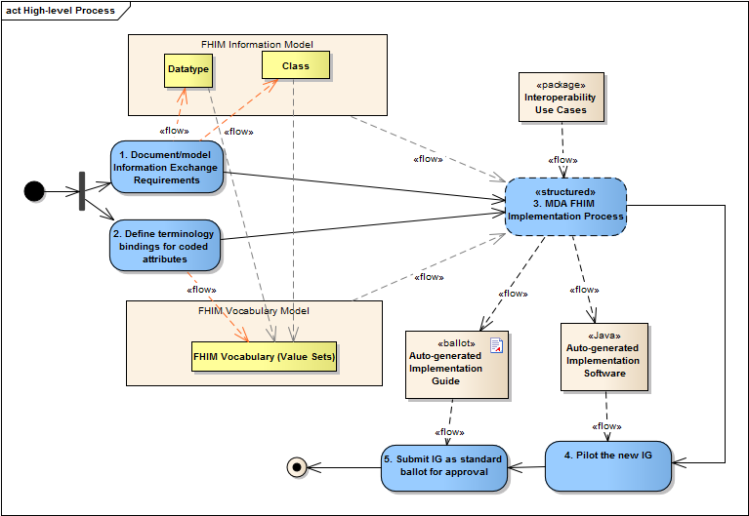
Implementation Process
Notes:
Document the information required for exchange in the FHIM Information Model. FHIM is a platform independent model (PIM) model describing the information exchange requirements of FHIM stakeholders. The result of this activity is to create a FHIM UML model organized into packages/domains. Each domain contains the information required to exchange information among systems in a specific business area.
Define terminologies and value sets for coded data attributes in the FHIM Terminology model. This FHIM Terminology is a UML model that contains all references to all coding system and value set versions used by coded attributes of FHIM classes. This model will also contain coding system version and subsets used by implementation guides based on FHIM.
Follow a Model Driven Architecture (MDA) process guide to produce a draft implementation guide as described in section 7. The following is a high-level summary of the approach:
Identify the specific use case(s) for exchange of information
Identify the target Platform Specific Model(s) (PSM) to support the exchange
Constrain the FHIM and associated terminologies/value sets to generate a PIM that contains the information needed to support the use case
Use the use case PIM to generate the target PSM
Use the PSM to generate artifacts for the target implementation standard
Pilot test the draft implementation containing constraints and extensions to the base standards in PSM and based directly on the contents of the PIM
Submit the draft implementation guide to an SDO/SRO for ballot/approval; if the project requirements require specific extensions in the base standards (i.e. PSM) additional change requests will be submitted for each extension or gap that needs to be addressed.

Slide 19
Auto-generated Java code
Based on
Underlying standard model
Adding IG-specific constraints
Java library
To instantiate CDA document conformant with the IG
To parse and validate content

Slide 20
Impact of the FHIM
8

Slide 21
Impacts
Provides a common understanding of information to be exchanged between federal partners (single source of truth)
Improves the level of interoperability that can be achieved
Reduces the time it takes to develop information exchange standards
Can improve the efficiency of developers in implementing information exchanges

Slide 22
How to Contribute
8

Slide 23




Federal Health IT Initiatives
Federal Health Information Model
http://fhims.org/
ONC website:
www.healthit.gov
Direct Project website:
www.directproject.org
S&I Framework wiki:
http://wiki.siframework.org
CONNECT website:
wiki.connectopensource.org
9

Slide 24


Stay Connected, Communicate and Collaborate
Schedule a meeting with me or send me your thoughts at: steven.wagner@hhs.gov
Subscribe, watch, and share:
@ONC_FHA
Federal Health Architecture
http://www.flickr.com/photos/federalhealtharchitecture/
10

Slide 25
Current and Planned Activities
8

Slide 26
Deliverables
Completed
Modeled 18 of 37 FHIM information domains
Represents approximately 80% of information exchanged
Modeled/defined terminologies/value sets for 11 of 37 FHIM domains
Integrated FHIM and associated terminology models with Model Driven Health Tools (MDHT)
Produced modeling process guides - Information, Terminology, Implementation
Prototyped of each individual process, model and tool
Prototyped of HIE Framework
Generated of a draft implementation standard in CDA & NIEM
Mapped 10 of 13 S&I Framework initiatives to the FHIM
Notes:
Information modeling of 18 of 37 FHIM information domains (e.g., Person, Lab, Medications/Pharmacy, Health Concerns/Problems, Orders, etc.)
Prototyping of HIE Framework (fully integrated processes, models and tools that support the Model Driven Architecture approach to generating HIE standards)
Generation of a draft implementation standard for the exchange of immunization information in both a CDA and NIEM formats
Definition of a UML profile to support enhanced report generation
Definition and generation of a draft comparative report between two versions of the FHIM

Slide 27
FHIM Information Domains - Modeling Status
FHIM Information Domains
Information Domain | Information Modeling Status | Terminology Modeling Status
AdverseEventReporting | Complete | Complete
Allergies | Complete | Complete
Assessment | Complete | To Be Modeled
Audiology And Speech Pathology | To Be Modeled | To Be Modeled
BehavioralHealth | Partially Complete | To Be Modeled
BloodBank | To Be Modeled | To Be Modeled
CarePlan | In Progress | In Progress
ClinicalDecisionSupport | To Be Modeled | To Be Modeled
ClinicalDocument | To Be Modeled | To Be Modeled
Consultation | To Be Modeled | To Be Modeled
Dental | To Be Modeled | To Be Modeled
Dietetics | To Be Modeled | To Be Modeled
Encounter | Complete | To Be Modeled
EnrollEligibilityCOB | Complete | To Be Modeled
HealthConcern | Complete | Complete
HomeBasedPrimaryCare | To Be Modeled | To Be Modeled
Imaging | To Be Modeled | To Be Modeled
Immunizations | Complete | Complete
Lab | Complete | Complete
OncologyRegistry | To Be Modeled | To Be Modeled
Orders | Complete | Complete
FHIM Information Domains
Information Domain | Information Modeling Status | Terminology Modeling Status
PatientEducation | To Be Modeled | To Be Modeled
Person | Complete | Complete
Medications/Pharmacy | Complete | In Progress
Prosthetics | To Be Modeled | To Be Modeled
Provider | Complete | Complete
Public Health Reporting | Complete | In Progress
Radiology | To Be Modeled | To Be Modeled
SecurityAndPrivacy | Complete | Complete
SocialWork | To Be Modeled | To Be Modeled
SpinalCord | To Be Modeled | To Be Modeled
Surgery | To Be Modeled | To Be Modeled
VitalSigns | Complete | Complete
WomensHealth | To Be Modeled | To Be Modeled
Common | Complete | To Be Modeled
Datatypes | Complete | Complete
In production
3

Slide 28
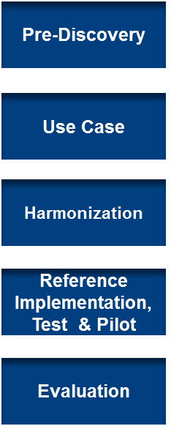
Engagement in the Standards & Interoperability (S&I) Framework
Support for federal partner priorities such as Meaningful Use
Direct support of federal partner use cases
Provides semantic and syntactic modeling constructs to support the definition of information
Combined with MDHT*, can be used to generate HIE standards using an MDA* approach
FHIM
S&I
Scope
Requirements
Modeling
* MDHT= Model Driven Health Tools
MDA= Model Driven Architecture
Publish
4

Slide 29

Your Comments/
Questions?
8

